Slide 1









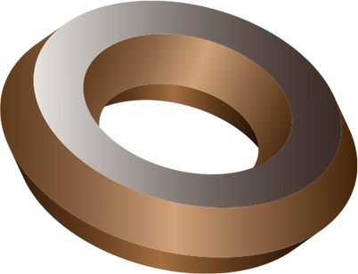

MODEL MYSTERY
Model
mystery
Transform your thoughts into designs
Saturday, november 4
St. Vincent pallotti college of Engineering And Technology

Slide 2
Round 1
Quiz
MODEL MYSTERY
Model
mystery
Transform your thoughts into designs

Slide 3
Quiz Starts in
60 seconds

Slide 4

Question 1
MODEL MYSTERY
A
Extrude
Which command is used to create 2D sketches that serve as the foundation for 3D models?
B
Revolve
C
Create Sketch
D
Pattern

Slide 5
Question 2
MODEL MYSTERY
A
Fillet
What command is used to add or remove material from a 2D sketch to create 3D solid features?
B
Create Sketch
C
Extrude
D
Loft

Slide 6
Question 3
MODEL MYSTERY
A
Rendering
what command is used to simulate the behavior of assemblies and mechanisms?
B
Joint Creation
C
Sculpting
D
Draft

Slide 7
Question 4
MODEL MYSTERY
A
Extrude
Which command is used to create a symmetrical copy of a component or feature?
B
Combine
C
Mirror
D
Sweep

Slide 8
Question 5
MODEL MYSTERY
A
.STP
What file format is commonly used to export a 3D model for 3D printing from Fusion 360?
B
.OBJ
C
.IGES
D
.STL

Slide 9
Question 6
MODEL MYSTERY
A
Square
What is the common 2D shape used as the base of a traffic cone sketch in Fusion 360?
B
Circle
C
Triangle
D
Hexagon

Slide 10
Question 7
MODEL MYSTERY
A
Select the feature, press Delete, and then create a new feature.
How can you edit a feature?
B
Right-click the feature and select Edit Feature.
C
Keep clicking Undo until the feature is gone.
D
Find the feature in the browser, select Remove, and then create a new feature.

Slide 11
Question 8
MODEL MYSTERY
A
Loft
Which tool is used to create the 3D cone from the 2D sketch?
B
Extrude
C
Revolve
D
Sweep

Slide 12
Question 9
MODEL MYSTERY
A
Extrude the cone shape
What is the first step in creating a traffic cone in Fusion 360?
B
Apply materials and colors
C
Create a new design or open an existing one
D
Add a reflective stripe

Slide 13
Question 10
MODEL MYSTERY
A
Shell
What command is used to hollow out a 3D model in Fusion 360, creating a shell with a specified thickness?
B
Sweep
C
Pattern
D
Fillet

Slide 14
Question 11
MODEL MYSTERY
A
Mirror
Which command is used to apply rounded edges or corners to a 3D model in Fusion 360?
B
Fillet
C
Sweep
D
Create Sketch

Slide 15
Question 12
MODEL MYSTERY
A
Combine
What command is used to duplicate and replicate components, bodies, or features in a linear or circular arrangement?
B
Pattern
C
Sweep
D
T-Spline Modeling

Slide 16
Question 13
MODEL MYSTERY
A
Pattern
which command allows you to rotate a 2D sketch profile around an axis to create a 3D feature?
B
Extrude
C
Revolve
D
Loft

Slide 17
Question 14
MODEL MYSTERY
A
Linux
What is Autodesk Fusion 360 designed for?
B
Windows/MACOS
C
macOS
D
Android

Slide 18
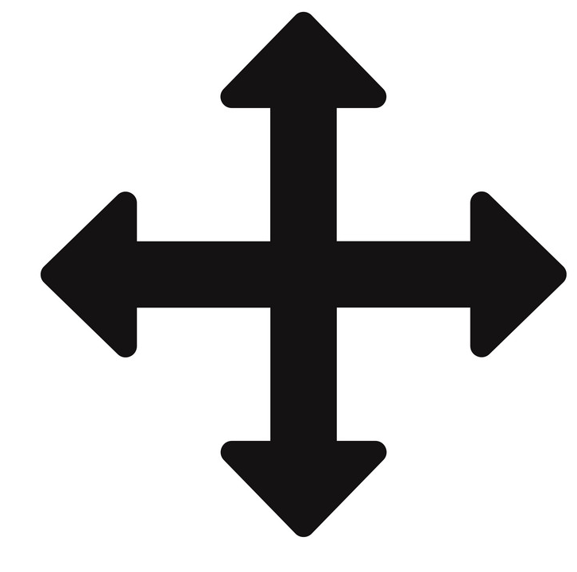
Question 15
MODEL MYSTERY
A
Edit Sketch
GUESS THE LOGO.
B
Move/copy
C
Nevigator
D
Sketch Dimensions

Slide 19
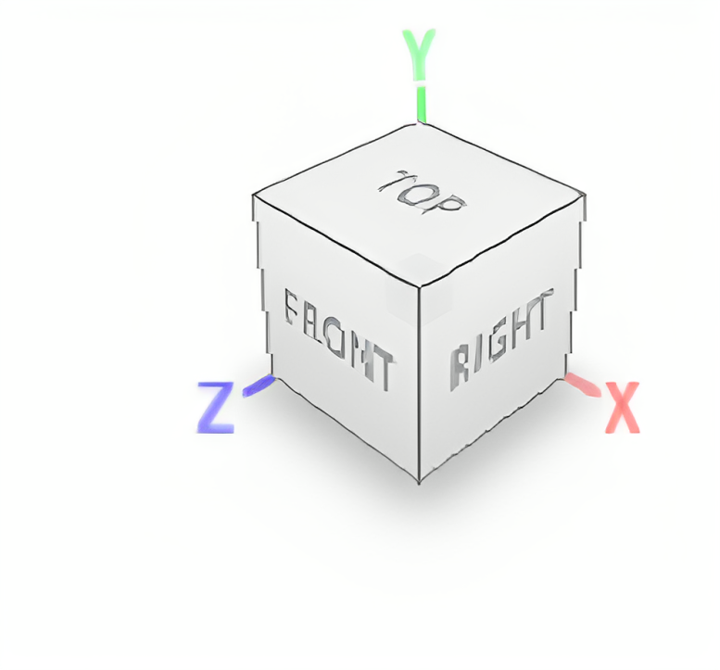
Question 16
MODEL MYSTERY
A
SOLID CUBE
Guess The LOGO.
B
VIEW CUBE
C
ROTATING CUBE
D
NEVIGATION CUBE

Slide 20
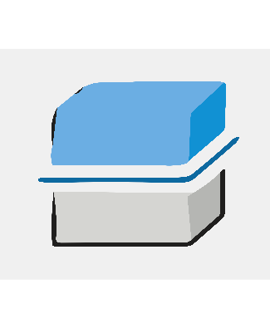
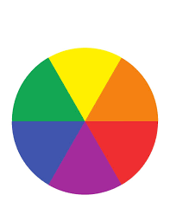

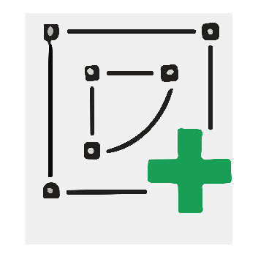
Match the pairs
MODEL MYSTERY
A
Create sketch
Question 17:
Question 18:
Question 19:
Question 20:
B
Construct Plain
C
Split Body
D
Apperance

Slide 21
Submit
Quiz
With in
30 sec
Otherwise Form will close

Slide 22
Thank
you
MODEL MYSTERY
Model
mystery
Transform your thoughts into designs

